Slide 1

Python Collections
Day 4

Slide 2
Let Us Revise all the topics covered
Conditional Statements (IF Else,Else IF)
Python For Loop
Python While Loop

Slide 3
Python String
String is nothing but words and sentences that we take as an input to our program.
Basically Strings are the collection of characters.
Generally we use some functions to do our string operations.
There is no as such data type in python. Any variable we take it is generally a string data type. We have to convert it into integer or float.

Slide 4
Some Important Python String Functions
capitalize()-Converts the first character to upper case.
count()-Returns the number of times a specified value occurs in a string.
find()- Searches the string for a specified value and returns the position of where it was found
replace()-Returns a string where a specified value is replaced with a specified value.
lower()-Converts a string into lower case.
upper()-Converts a string into upper case.

Slide 5
Python String Slicing
We can trim or slice a string by using string functions.
We have to use split using split() function.
We can CONCATINATE String by using + symbol
To combine text we have to use combine() function.
We can format string by using format() function.

Slide 6
Python String Operators
\’
\\
\n
\r
\t
\b
\f
\ooo
\xhh

Slide 7
Python Collections
Collections are special data types that is present in python. There are a few data type in python that is used for collection rather than array.
The popular python collections are
List
Set
Touple
Dictionary

Slide 8
Python Lists
Lists are ordered, muteable(copy able), collection that defined into a third bracket.
Features of Lists
Ordered: They contain elements or items that are sequentially arranged according to their specific insertion order.
Zero-based: They allow you to access their elements by indices that start from zero.
Mutable: They support in-place mutations or changes to their contained elements.
Heterogeneous: They can store objects of different types.
Growable and dynamic: They can grow or shrink dynamically, which means that they support the addition, insertion, and removal of elements.
Nestable: They can contain other lists, so you can have lists of lists.
Iterable: They support iteration, so you can traverse them using a loop or comprehension while you perform operations on each of their elements.
Sliceable: They support slicing operations, meaning that you can extract a series of elements from them.
Combinable: They support concatenation operations, so you can combine two or more lists using the concatenation operators.
Copyable: They allow you to make copies of their content using various techniques.
Let us look at some LIST Examples to understand List more properly.

Slide 9
Python Set
A Set in Python programming is an unordered collection data type that is changeable and has no duplicate elements.
Features Of Set
Sets are unordered.
Set elements are unique. Duplicate elements are not allowed.
A set itself may be modified, but the elements contained in the set must be of an immutable type.
Let us look at some Set Examples to understand Set more properly.

Slide 10
Python Tuple
Python Tuple is a collection of objects separated by commas. In some ways, a tuple is similar to a Python list in terms of indexing, nested objects, and repetition but the main difference between both is Python tuple is immutable, unlike the Python list which is mutable.
Features of Tuple
Ordered:- When we say that tuples are ordered, it means that the items have a defined order, and that order will not change.
Unchangeable:- Tuples are unchangeable, meaning that we cannot change, add or remove items after the tuple has been created.
Allow Duplicates:- Since tuples are indexed, they can have items with the same value.
Lets take a look at some tuple function to understand more clearly.

Slide 11
Python Dictionnary
Dictionaries stores data categorically maintaining a proper catalogue.
Dictionaries are used to store data values in key:value pairs
We have to print the dictionary to print the values inside it.
Dictionary items are ordered, changeable, and does not allow duplicates.
We can use dict() constructor to make a dictiionary.
A dictionary within a dictionar called nested dictiionary.
Lets take a look at some dictionary function to understand more clearly.

Slide 12
Thank You very much for attending this presentation
If you have any question you are free to ask

Slide 13
Python Math and Random Modules
(NumPy)
Day 5

Slide 14
Python Math Module
Sometimes when working with some kind of financial or scientific projects it becomes necessary to implement mathematical calculations in the project. Python provides the math module to deal with such calculations. Math module provides functions to deal with both basic operations such as addition(+), subtraction(-), multiplication(*), division(/) and advance operations like trigonometric, logarithmic, exponential functions.
Lets take a look some Random Function examples to know more about Random

Slide 15
What is Numpy?
NumPy is a Python library used for working with arrays.
It also has functions for working in domain of linear algebra, fourier transform, and matrices.
Features of Numpy
In Python we have lists that serve the purpose of arrays, but they are slow to process.
NumPy aims to provide an array object that is up to 50x faster than traditional Python lists.
The array object in NumPy is called ndarray, it provides a lot of supporting functions that make working with ndarray very easy.

Slide 16
Installation of Numpy
Installation of NumPy
If you have Python and PIP already installed on a system, then installation of NumPy is very easy.
Install it using this command:
C:\Users\Your Name>pip install numpy

Slide 17
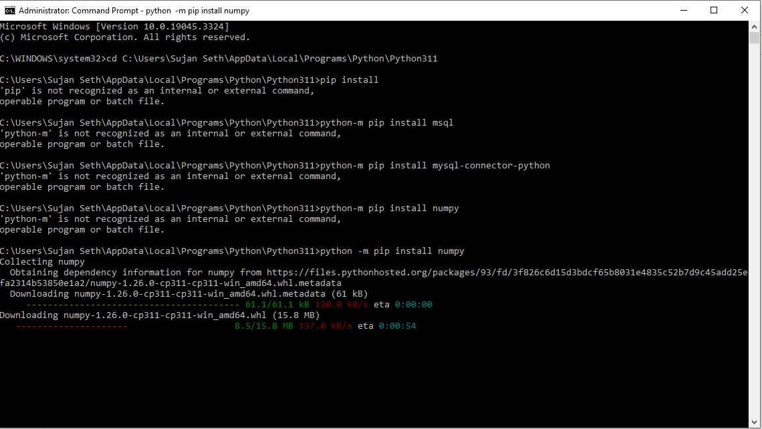

Slide 18
Let us see some numpy examples to learn NumPy

Slide 19
Pseudo Random and True Random
Computers work on programs, and programs are definitive set of instructions. So it means there must be some algorithm to generate a random number as well.
If there is a program to generate random number it can be predicted, thus it is not truly random.
Random numbers generated through a generation algorithm are called pseudo random.
Lets take a look some Random Function examples to know more about Random

Slide 20
Let us see some Random examples to learn Random Function

Slide 21
Thank You very much for attending this presentation
If you have any question you are free to ask

